Slide 1
Predicting the Price of Bitcoin
Gregory DeSantis

Slide 2
Context
Blockchain technology was first implemented by Satoshi Nakamoto in 2009 as a core component of Bitcoin, which is a distributed, public ledger recording transactions.
Allows secure peer-to-peer communication by linking blocks containing hash pointers to a previous block, a timestamp, and transaction data.
Bitcoin is a decentralized digital currency (cryptocurrency) which leverages the Blockchain to store transactions in a distributed manner in order to mitigate against flaws in the financial industry.
The motivation behind this project is to help those who have an interest in trading Bitcoin but perhaps are detoured by its inherent volatility by providing some predictive analytics.

Slide 3
Content
This data set comes from Kaggle and features Bitstamp, a bitcoin exchange based in Luxembourg.
The time period of this data set is from January 1, 2012 to August 12, 2019, with minute to minute updates of OHLC (Open, High, Low, Close), and weighted bitcoin price (4 million lines in total).
Timestamps without any trades or activity have their data fields forward filled from the last valid time period.
If a timestamp is missing, or if there are jumps, this may be because the exchange (or its API) was down, the exchange (or its API) did not exist, or some other unforseen technical error in data reporting or gathering.

Slide 4
Cleaning
Removed misprint prices. These were prices that were clearly out of the daily price range.
Converted timestamps from Unix time to yyyy-mm-dd format for time series analysis.
Grouped by date and took the closing prices mean as this is a significant reference point for determining performance over a specific time period.

Slide 5
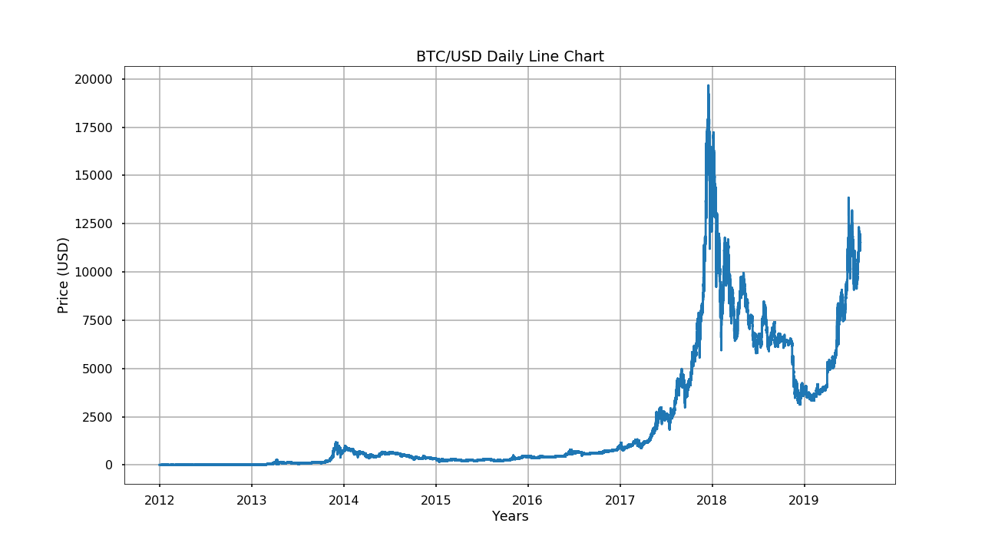
Explore

Slide 6
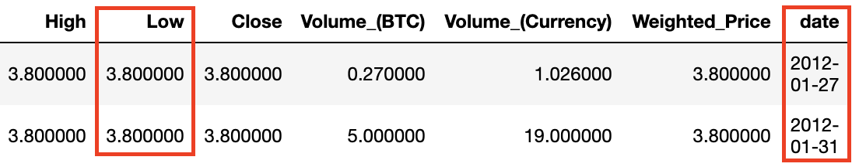
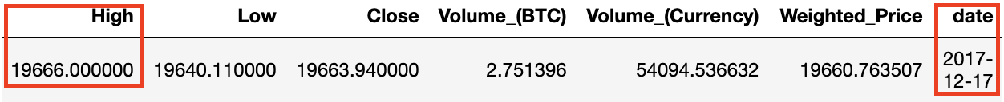
Explore
All time low price from the daily line chart was $3.80 and occured on January 27, 2012 and again on January 31, 2012.
All time high price from the daily line chart was $19,666 and occured on December 17, 2017.

Slide 7
Golden Cross
The golden cross is a technical chart pattern indicating the potential for a major market rally.
The golden cross appears on a chart when a security's short term moving average crosses above its long term moving average.
The short term moving average used was a 50-day exponential and the long term moving average used was a 200-day exponential.

Slide 8
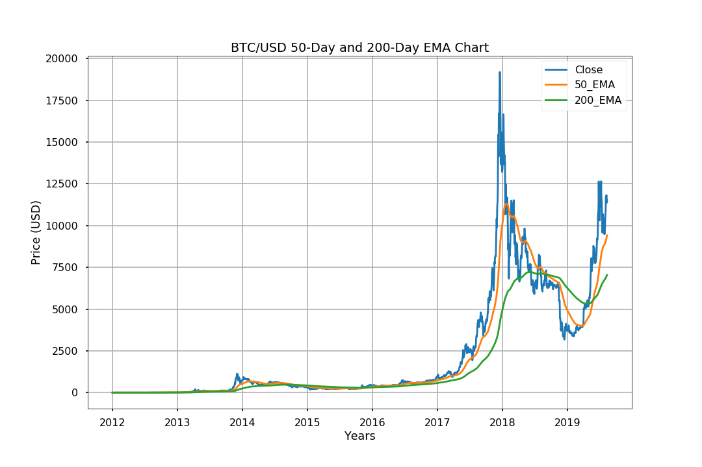
Golden Cross

Slide 9
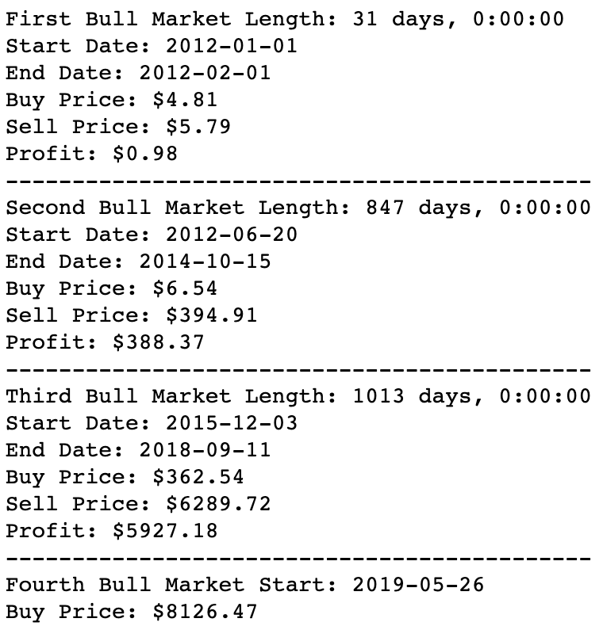
Golden Cross
Start date is when 50-day EMA crosses above the 200-day EMA.
End date is when 50-day EMA crosses below the 200-day EMA.
This strategy assumes one Bitcoin was purchased on the start date and sold on the end date.
Issue here can be observed in the Third Bull Market. We left $13,377 in potential profits on the table (ATH $19,666 - Sell Price $6,289)

Slide 10
Short Term Cross
Like the golden cross, the short term cross indicates the potential for a market rally but does so much sooner.
Short term cross is calculated using 12-day and 26-day EMAs.
Potential downfall with this strategy is greater risk because of higher frequency of trades.

Slide 11
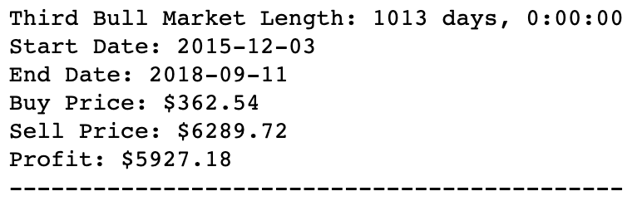
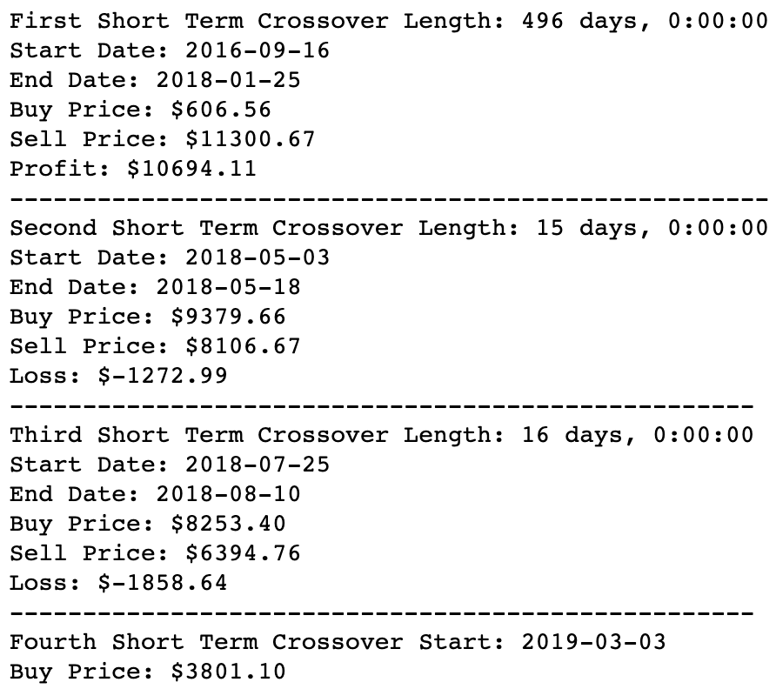
Short Term Cross
LEFT (50-DAY and 200-DAY EMA)
Length: 1013 days
Range: 12/3/2015 to 9/11/2018
Profit: $5,927
RIGHT (12-DAY and 26-DAY EMA)
Length: 527 days
9/16/2016 to 7/25/2018
Profit: $7,564

Slide 12
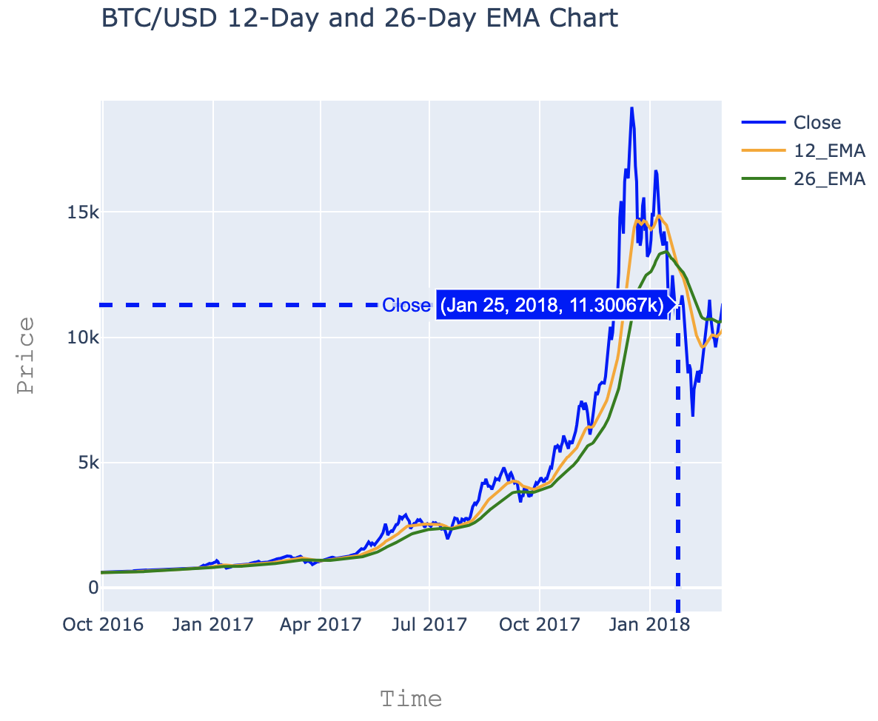
Short Term Cross

Slide 13
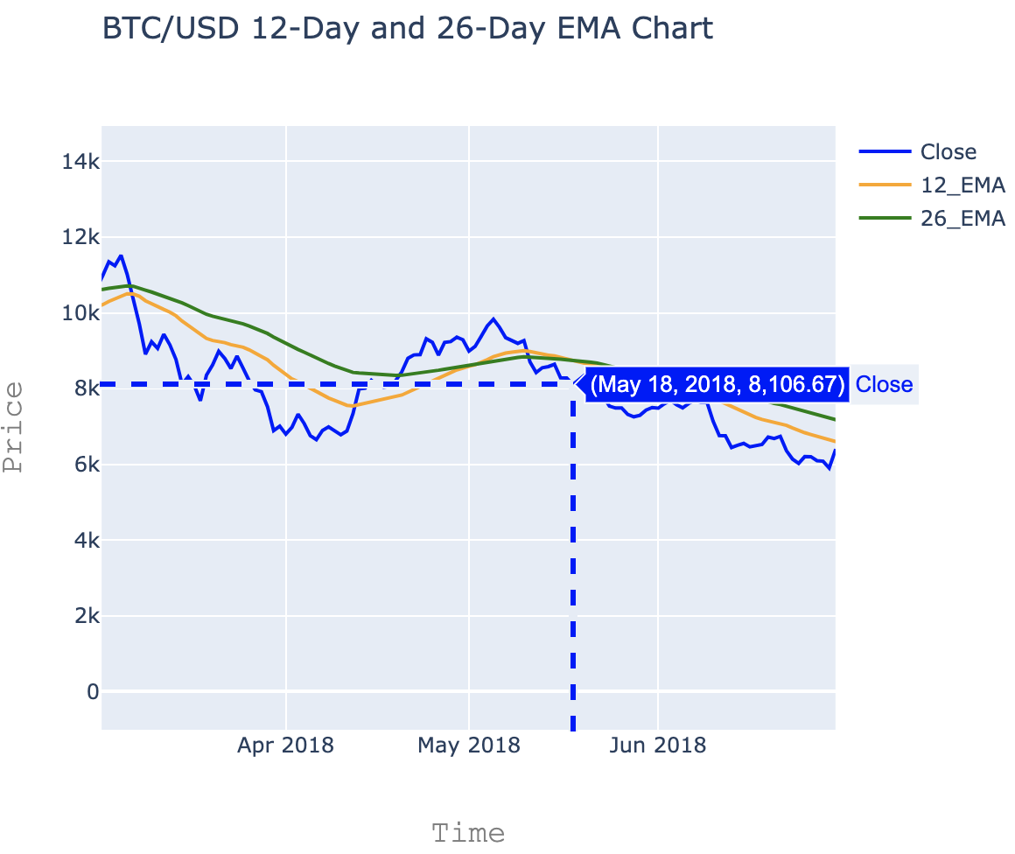
Short Term Cross

Slide 14
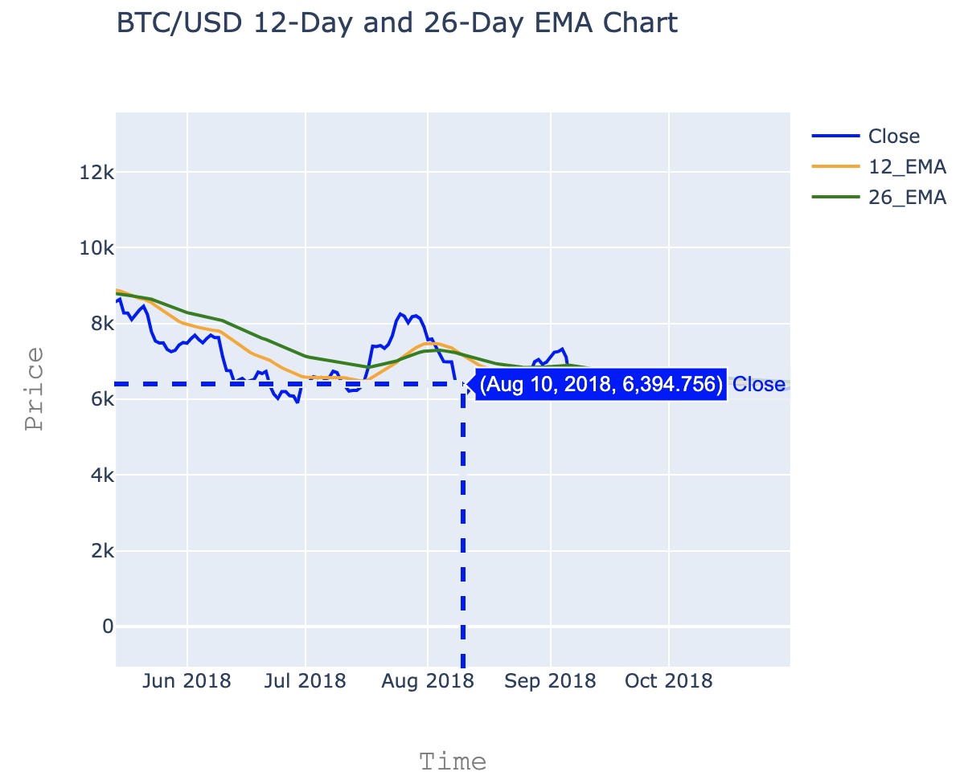
Short Term Cross

Slide 15
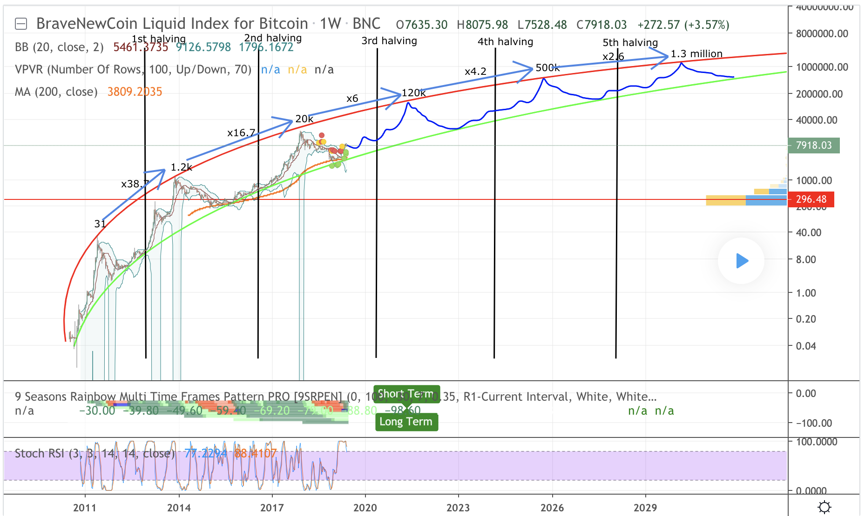
Long Term BTC Chart

